Slide 1
Flight Destination
File created on: 10/02/2025 18:23:08

Slide 2
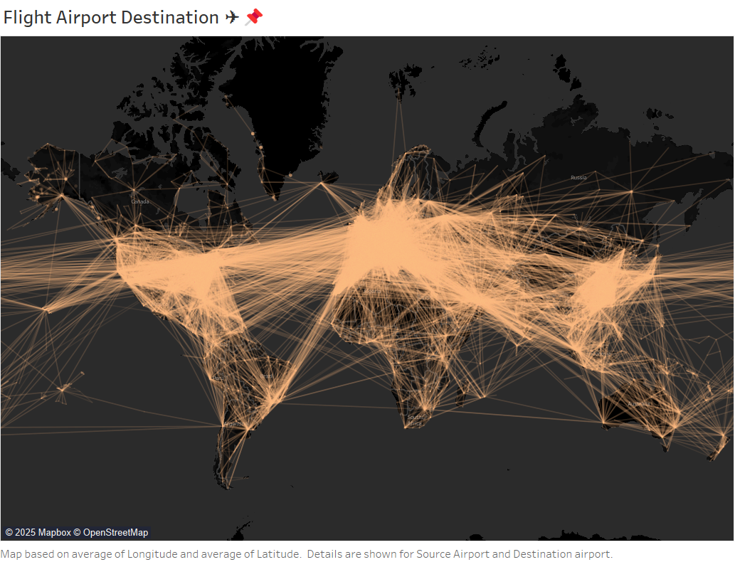

Slide 3
